Slide 1
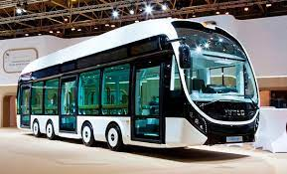
Online Bus Booking System
Group-04

Slide 2

TEAM MEMBERS :
Anupma Singh (Team leader)
Somineni Lavanya
Mayoor N K
Pudu Venkata Subba Reddy
Pradeep Raj S
Roshan Thomas
Sreeramoju Sathwik
Md Talib Alam

Slide 3
CONTENTS
1. Introduction
2. Scope
3. Existing System
4. Proposed System
5. Technologies used in this project
6. Flow diagrams
7. ANGULAR APPLICATION ARCHITECTURE
8. SPRING BOOT APPLICATION ARCHITECTURE
9. Application Interfaces
10.Advantages
11. Disadvantages
12. Conclusions

Slide 4
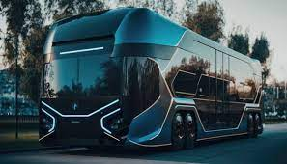
1. Introduction
An Online Bus Booking System is a web application that allows users to search, select, and book bus tickets for their desired routes and travel dates.
It typically involves both a backend system and a frontend user interface to provide a seamless booking experience.
In this case, we mentioned using Spring Boot for the backend and Angular for the frontend.

Slide 5
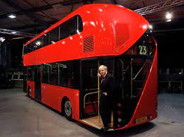
2. SCOPE
The scope of the online bus booking system are:
User Registration and Authentication
Route and Schedule Management
Seat Selection and Booking
Payment Integration
User Reviews and Ratings
Cancellations and Refunds
Admin Dashboard
Reporting and Analytics

Slide 6
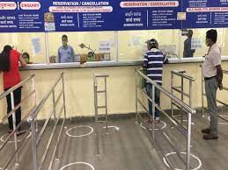
3. Existing System :
Physical Ticket Counters
Phone Reservations
Third-Party Travel Agencies
Limited Availability Information
Payment Methods through cash or bank transfer

Slide 7
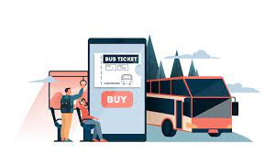
4. Proposed System
Web and Mobile Platforms
Real-Time Information
User Accounts
Digital Payments
Seat Selection
Instant Confirmation
Cancellation and Refunds
Reviews and Ratings
Admin Dashboard
Customer Support

Slide 8





5. Technologies used in this project
Frontend:
VisualStudio Code IDE
Angular
Node js & Npm
Angular CLI
Bootstrap

Slide 9






Backend:
Spring Boot
Maven
Spring Data JPA
JDK 1.8
Embedded Tomcat server
MySQL Database

Slide 10
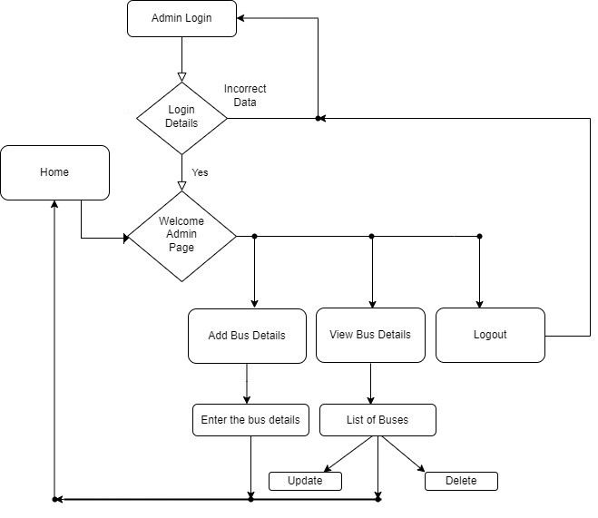
6. Flow-diagrams:

Slide 11
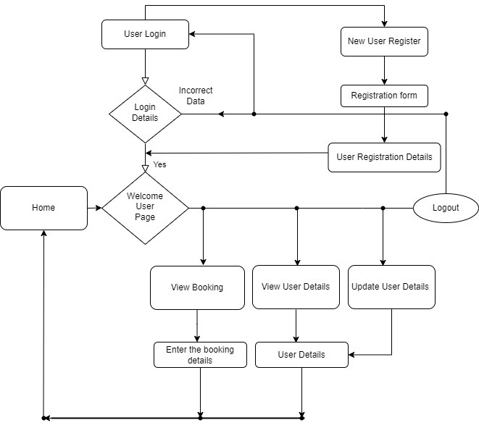

Slide 12
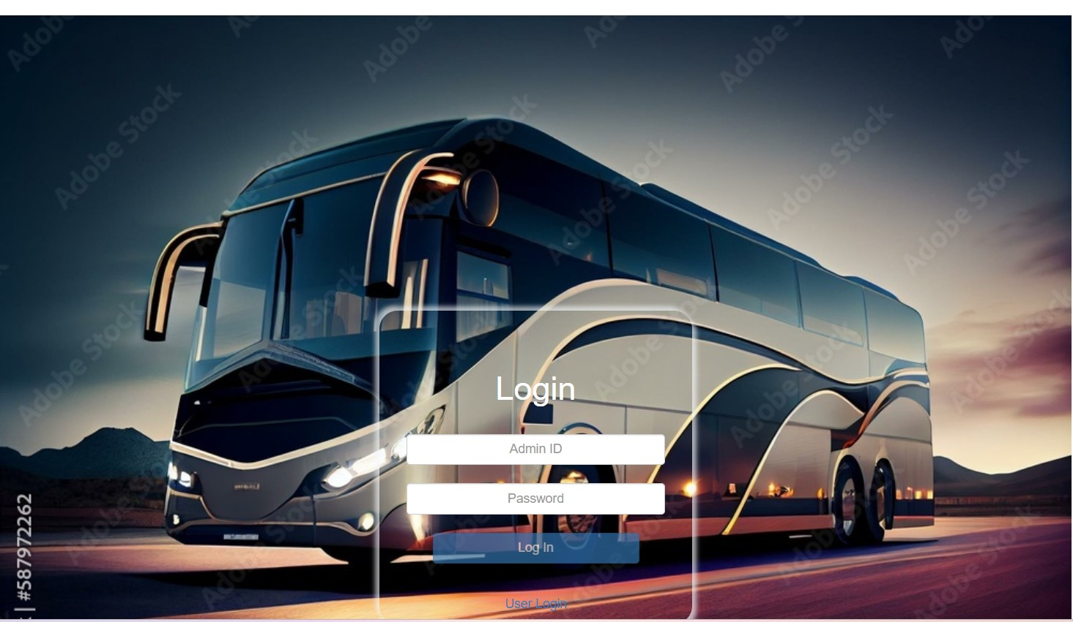
9. Application Interfaces

Slide 13
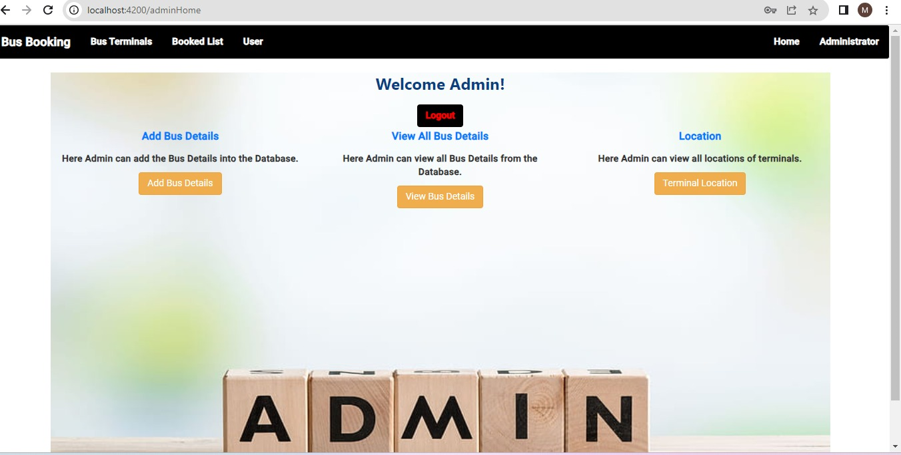

Slide 14
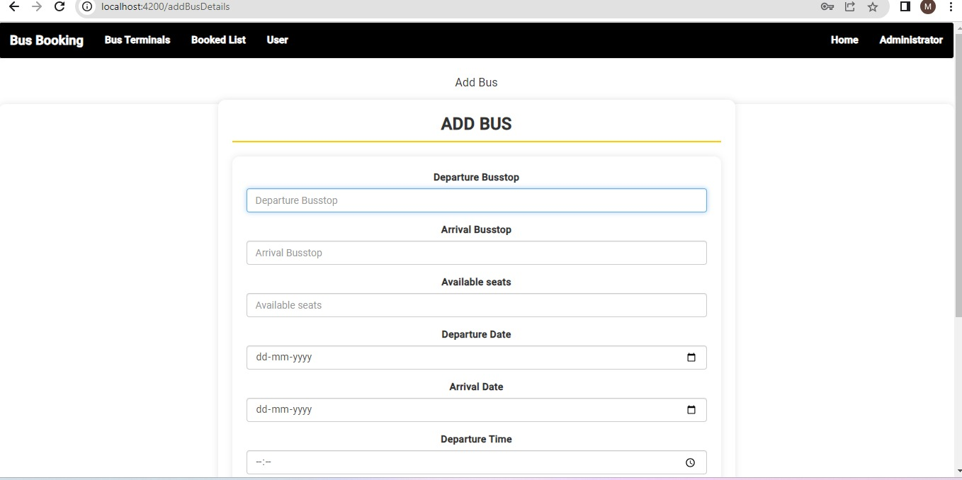

Slide 15
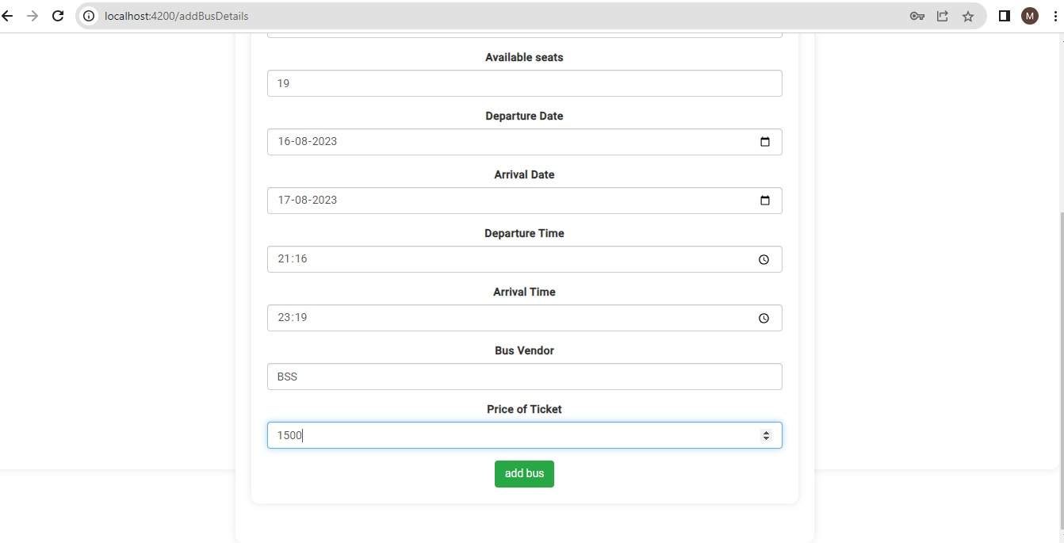

Slide 16
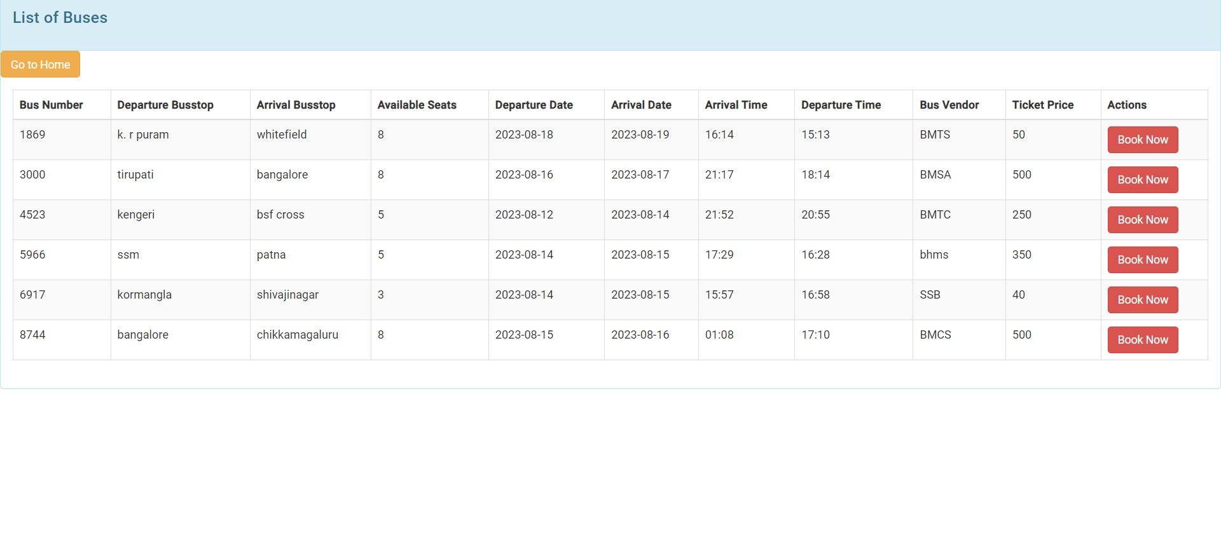

Slide 17
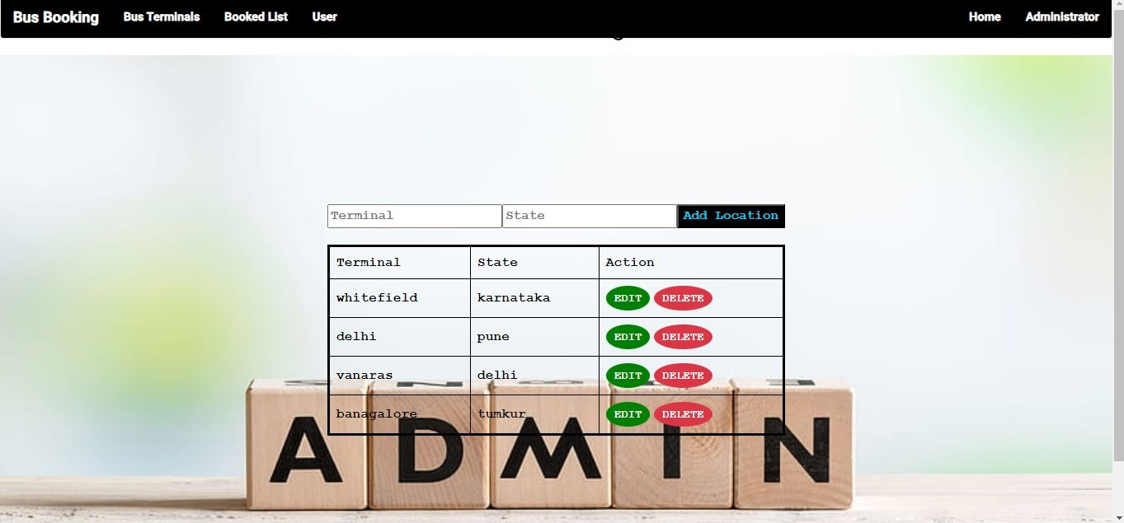

Slide 18
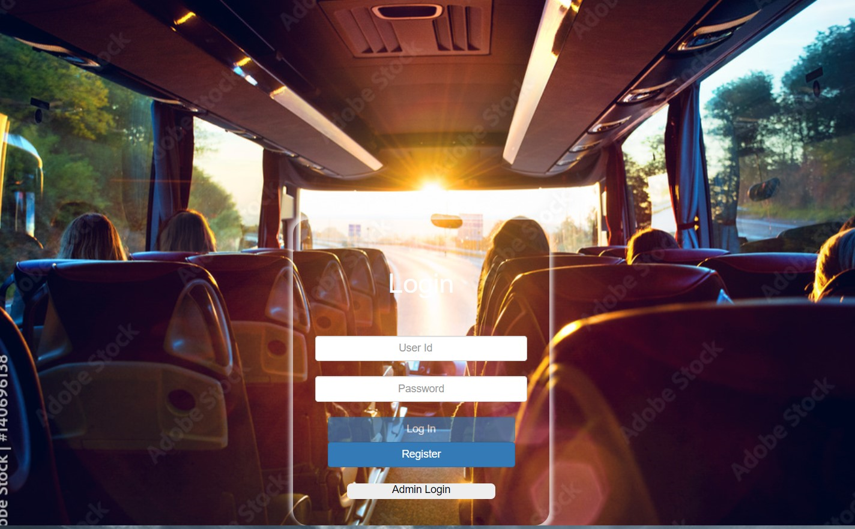

Slide 19
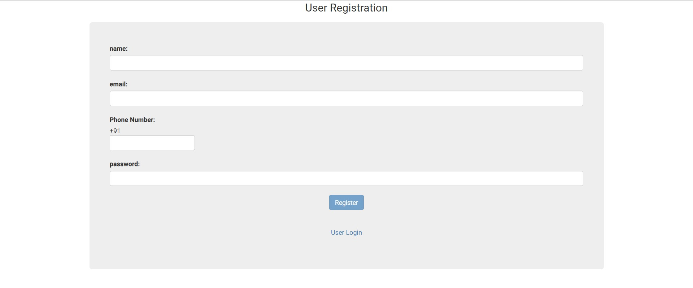

Slide 20
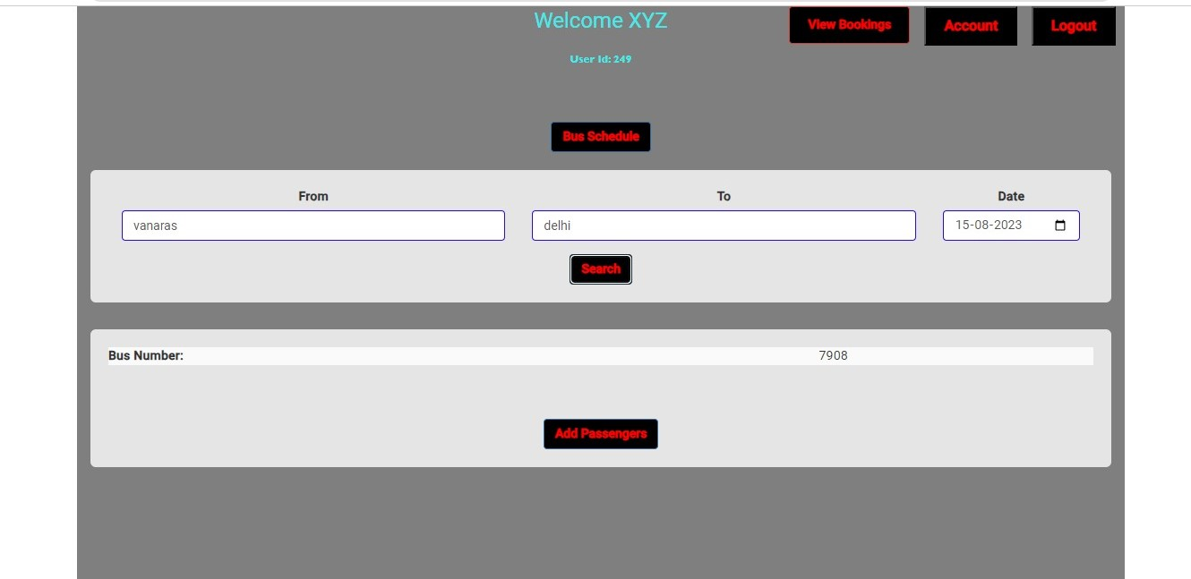

Slide 21
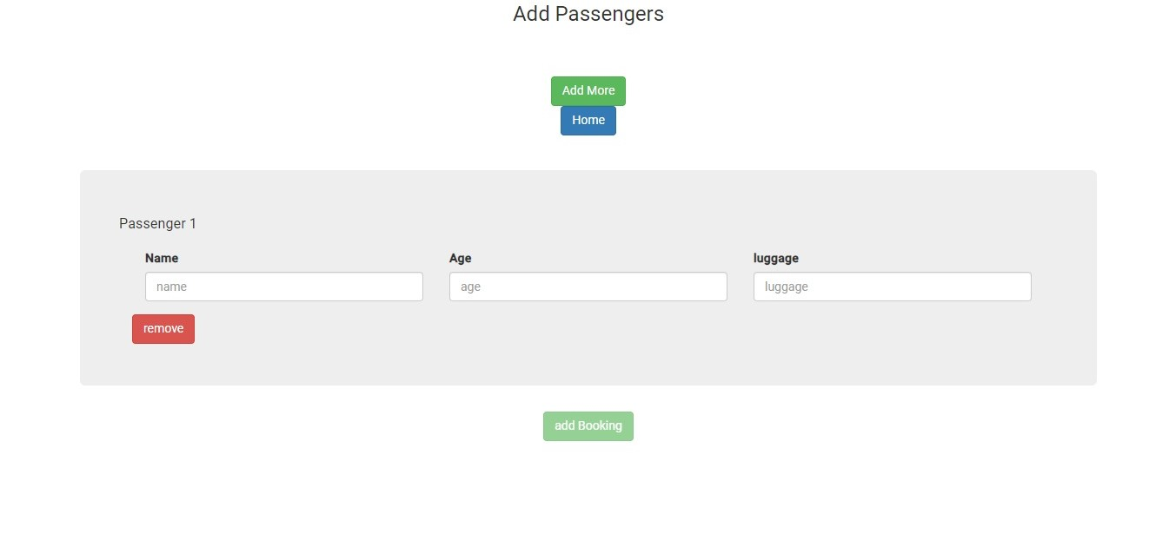

Slide 22
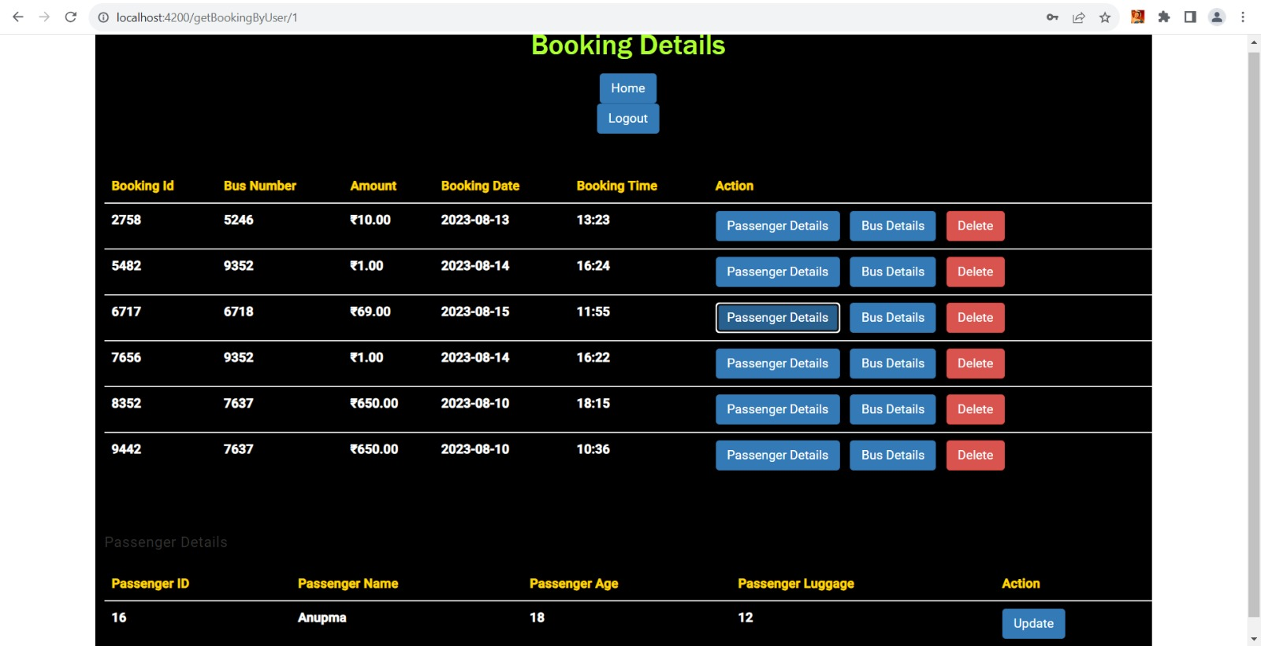

Slide 23
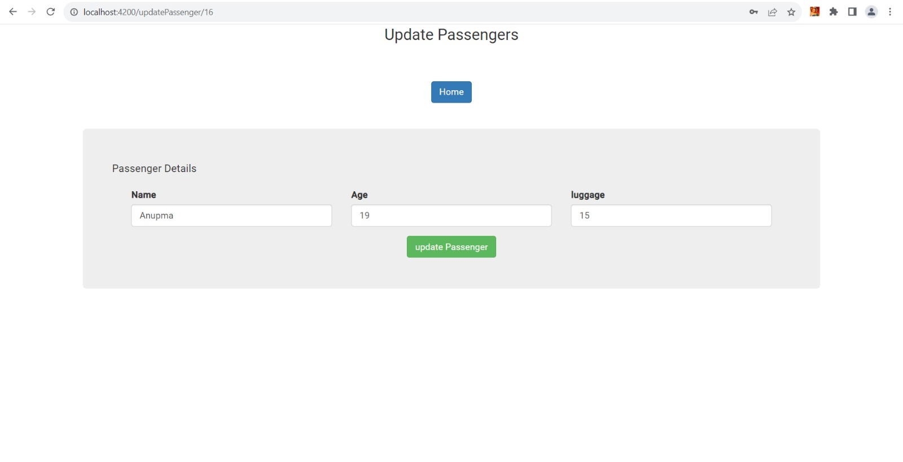

Slide 24
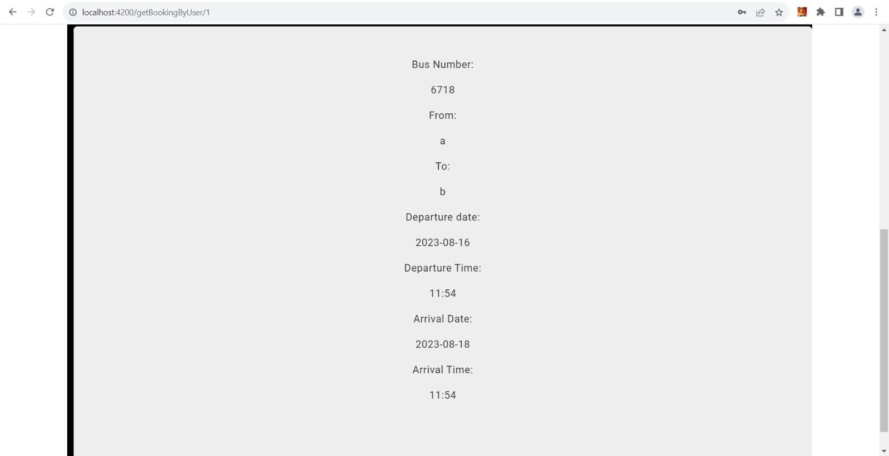

Slide 25
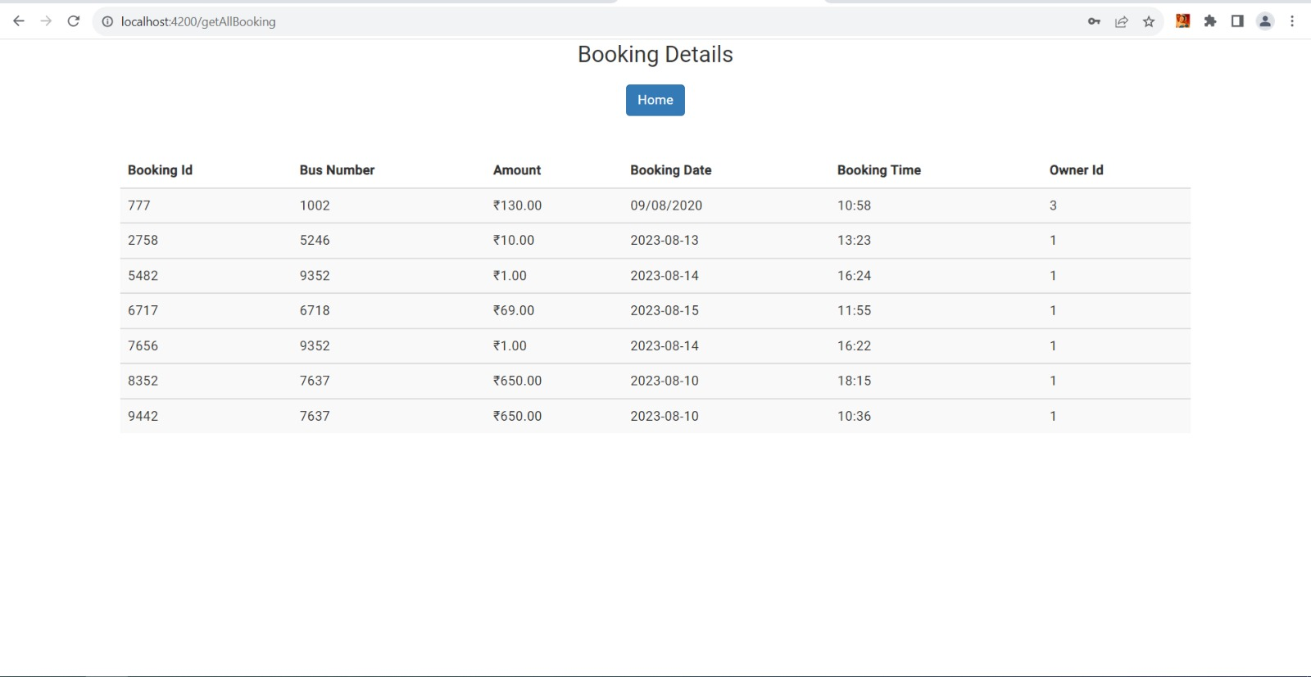

Slide 26
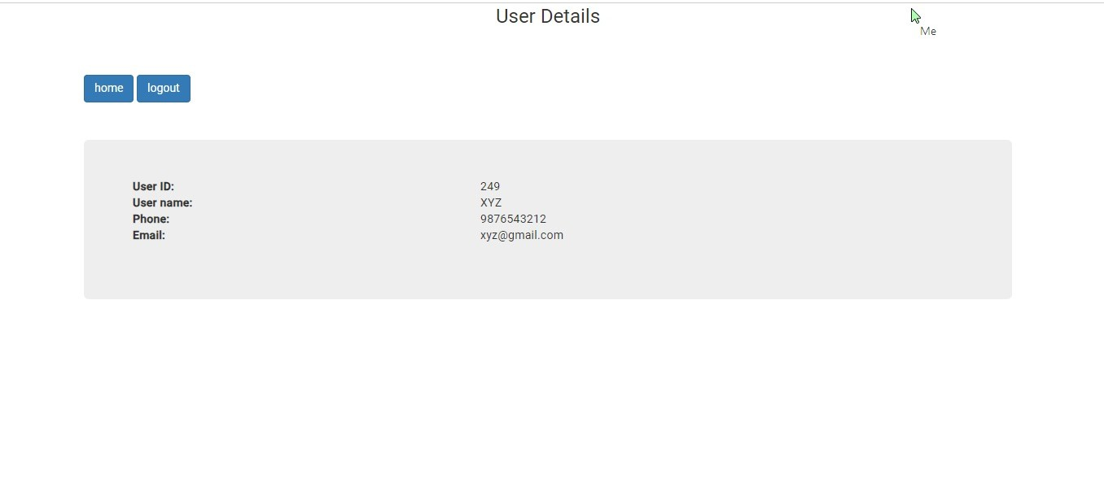

Slide 27
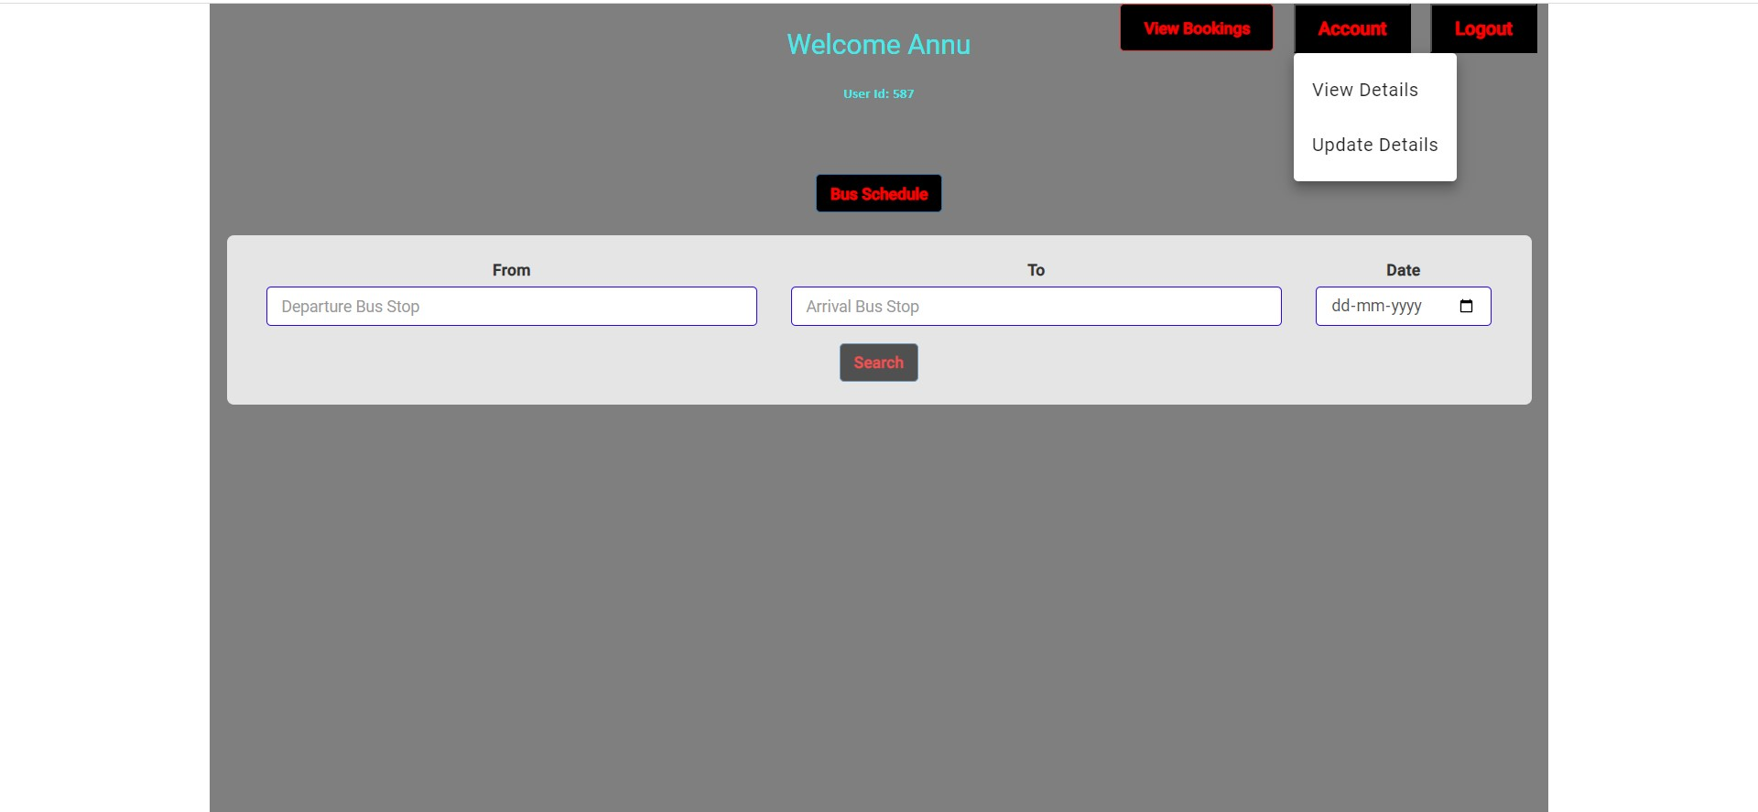

Slide 28
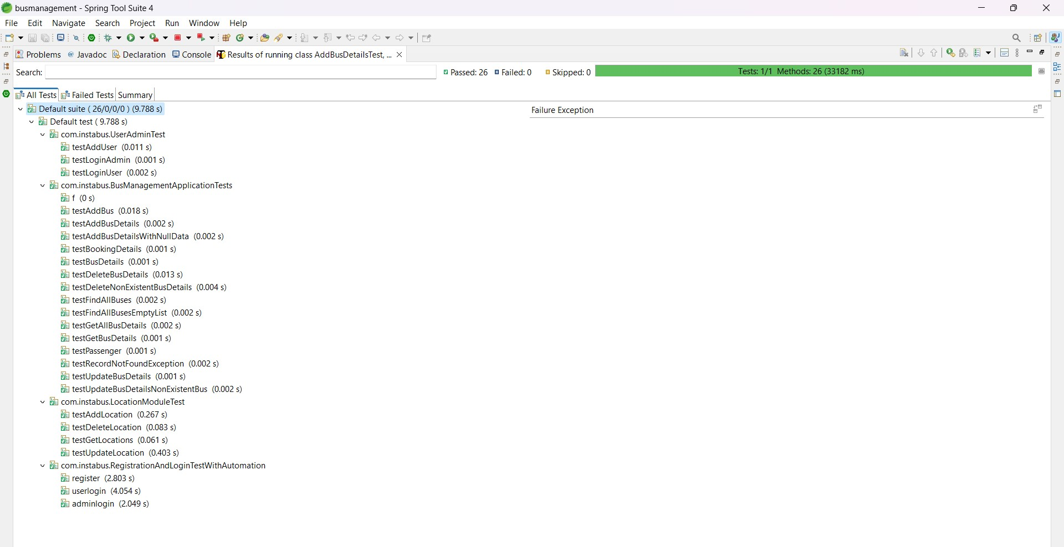

Slide 29
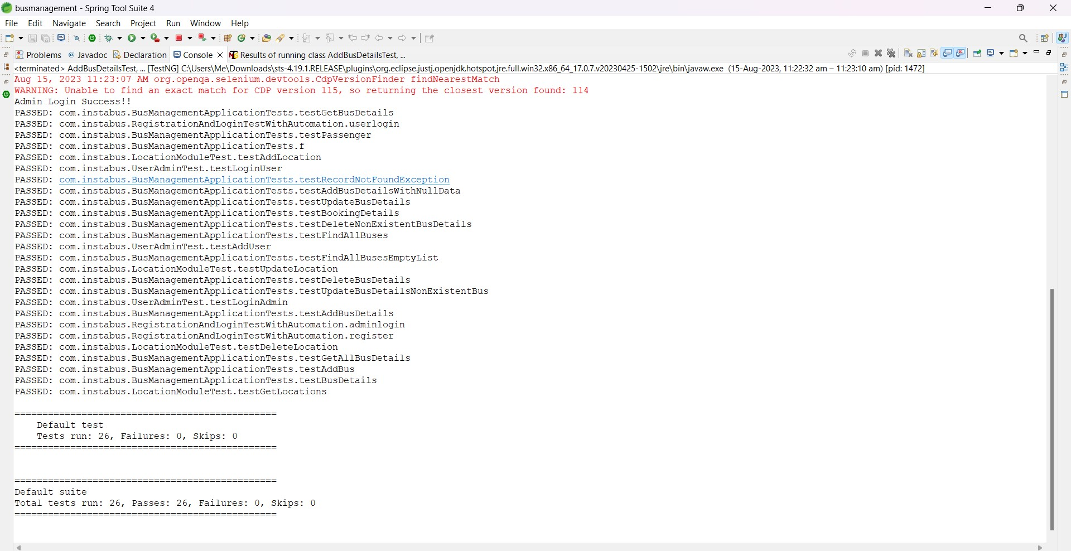

Slide 30
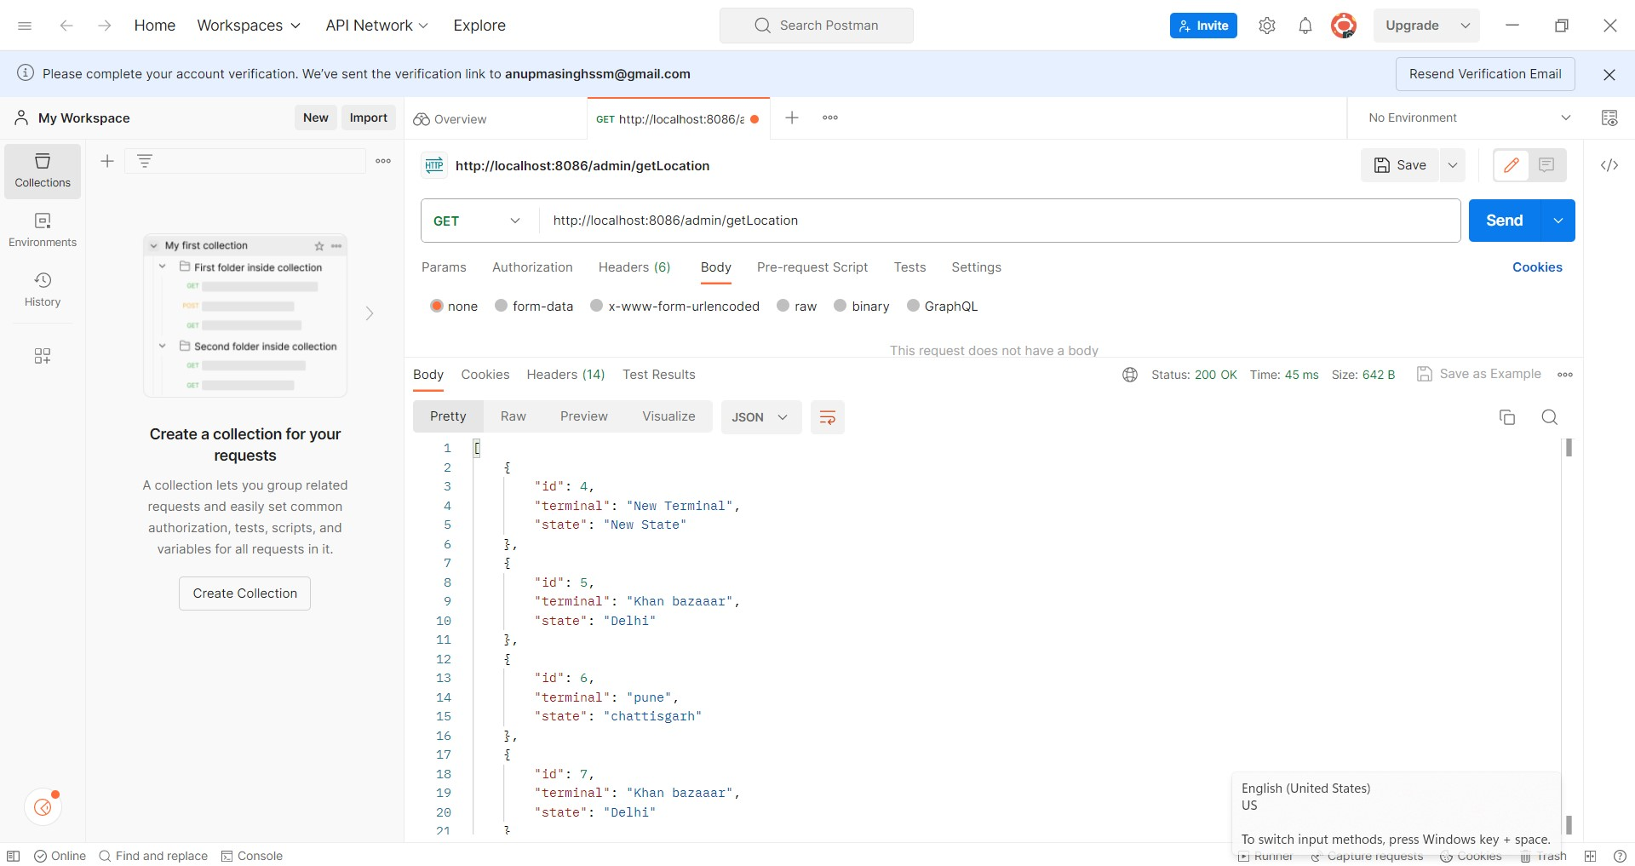

Slide 31
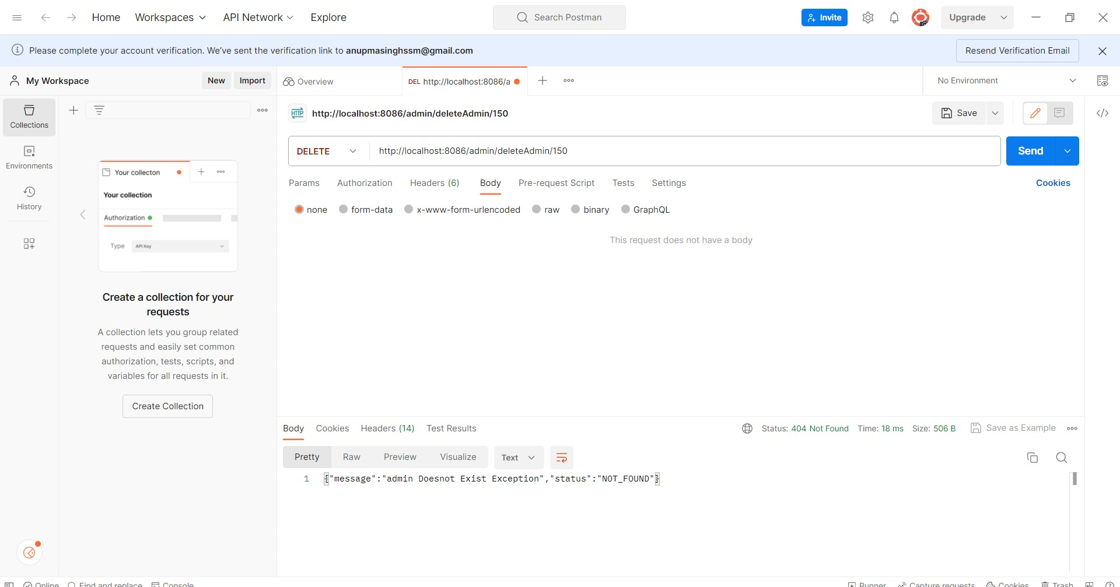

Slide 32
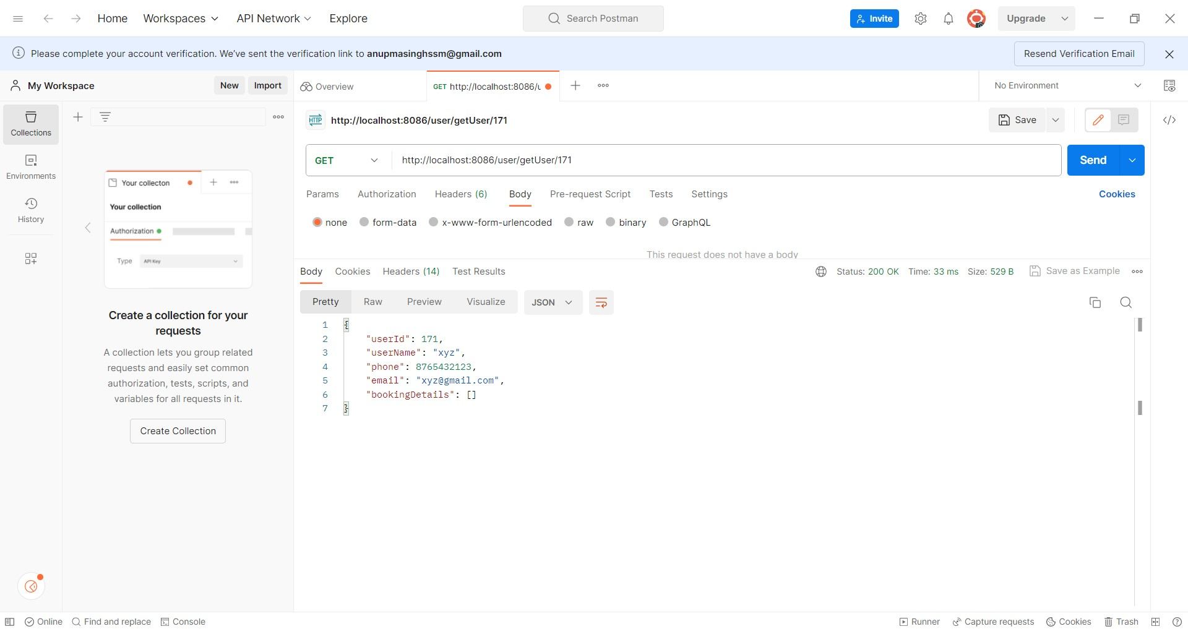

Slide 33
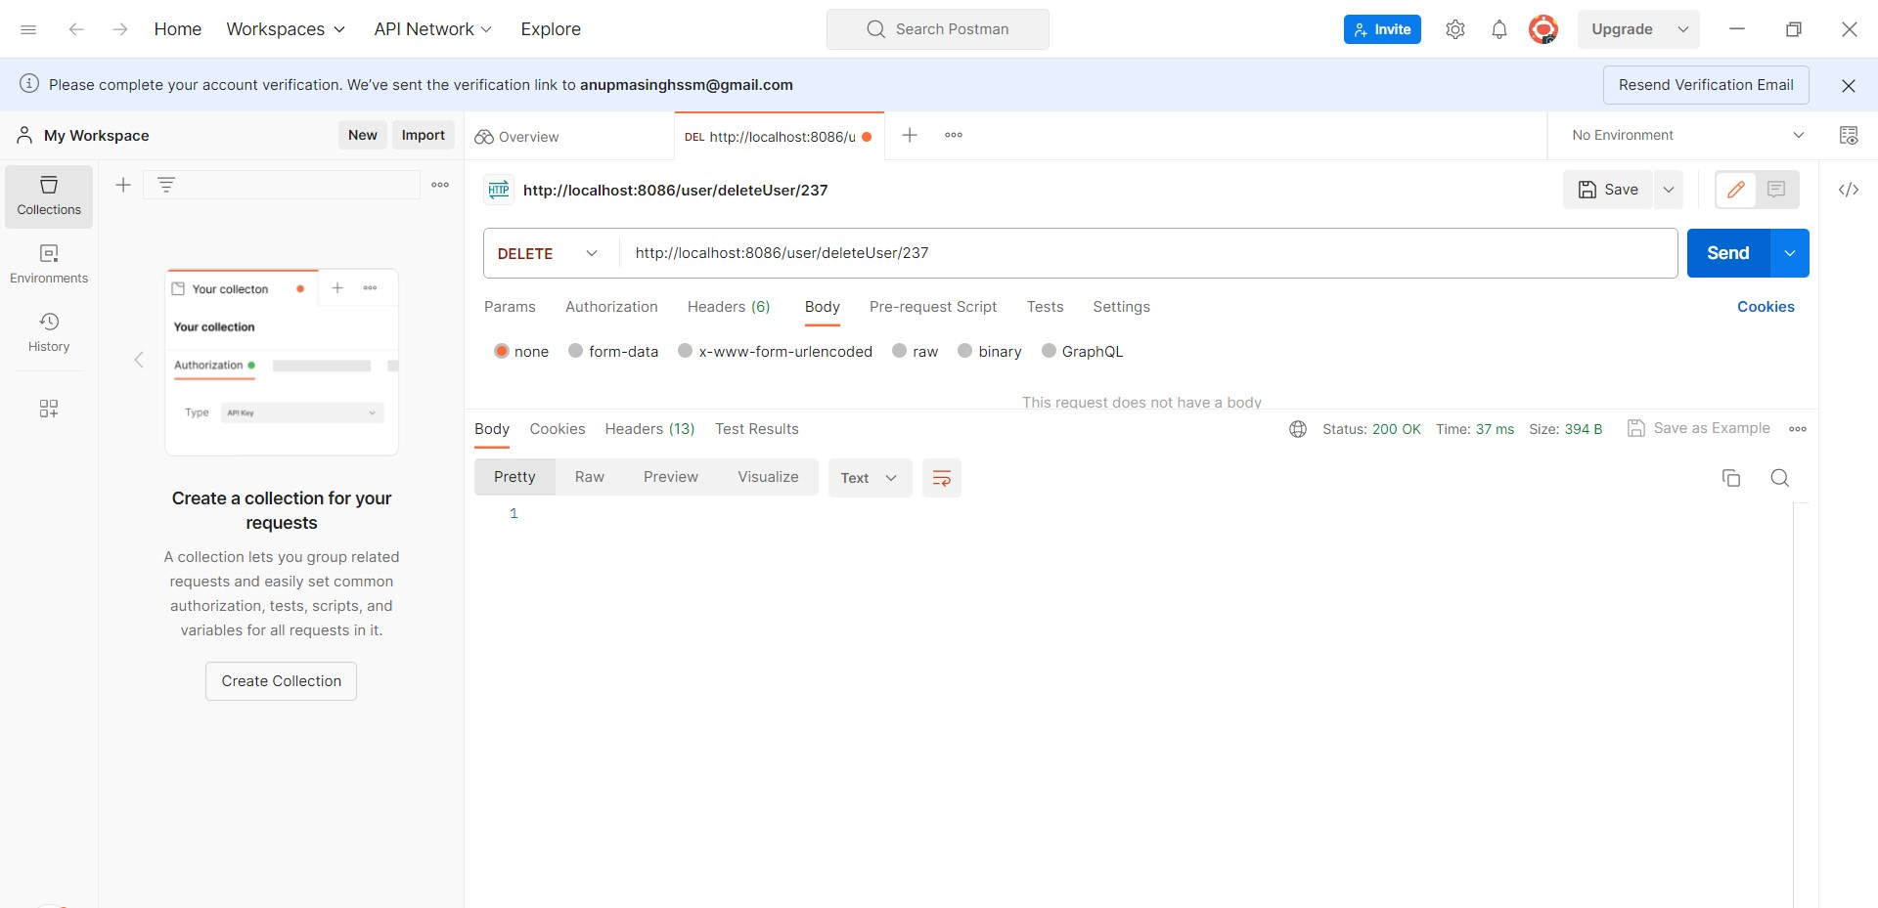

Slide 34
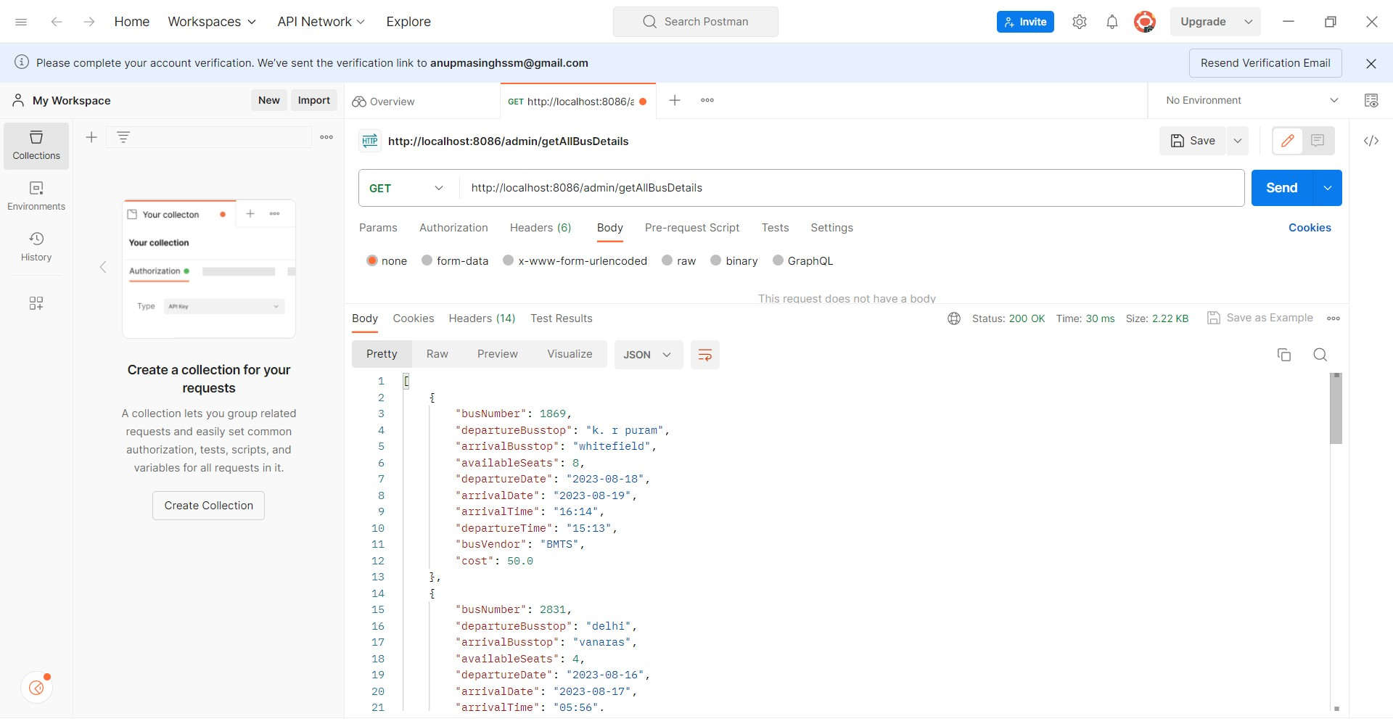

Slide 36
10. Advantages of online bus booking System:
24/7 Accessibility
Convenient Search and Selection
Seat Selection and Personalization
Instant Booking Confirmation
Online Payments
Reduced Queue Times
Flexibility and Last-Minute Booking

Slide 37
11. Disadvantages of online bus booking System:
Technical Challenges
System Downtime
Privacy and Security Concerns
User Errors
Hidden Costs
Limited Personal Interaction
Booking Constraints
Dependency on Technology

Slide 38
Conclusion:
Convenience and Accessibility: Online bus booking systems provide anytime access to schedules, seat choices, and payments, making travel planning convenient for users.
Real-Time Information: Travelers benefit from up-to-date route details, seat availability, and instant booking confirmations, enhancing decision-making.
Operational Efficiency: These systems streamline administrative tasks for operators, optimizing scheduling, seat allocation, and overall management.
User Empowerment: User reviews and ratings foster continuous improvement, enhancing customer satisfaction and service quality.
Future Growth Potential: While facing challenges, the online bus booking system's user-friendly approach and digital advancements position it for further expansion and technological integration.

Slide 39
THANK YOU

